Slide 1
7. Measurements of lightning electric and magnetic fields

Slide 2
Course Sections | Number of Lectures | HW Due (Canvas) | Test (Honor-lock) | Section in Course Packet | Chapter/Sections in Text (FOL)
5. Calculation of lightning electromagnetic fields | 4 | HW6 04/14 | T6 04/16 | 5 | 5, App. 3
6. Modeling of lightning processes | 3 |  |  | 6 | 6
7. Measurements of lightning electric and magnetic fields | 2 |  |  | 7 | 7
8. Lightning locating systems and lightning protection | 2 | - | - | 8,9 | 8,9
Review | 1 |  |  | 1-9 | 1-9, App. 1-4
Final Exam (via Honorlock) | - | - | Apr. 28 (W) 12:30-2:30 p.m. | 1-9 | 1-9, App. 1-4

Slide 3
Illustration of the principle of operation of the flat-plate antenna. (a) Antenna without external circuit. (b) Antenna with external integrating capacitor C>>C_{a}. Drawing by Potao Sun.

Slide 4
Norton equivalent circuit of electric field antenna shown along with the integrating capacitance and the input impedance of recorder (usually C>>C_{a} and C>>C_{in}). Drawing by Potao Sun.
V_{out} = (ε₀AE/C) if R_{in} >> 1/(ωC

Slide 5
For a unit-step-function E-field waveform,
V_{out} = (ε₀AE/C) exp(-t/(R_{in}C)),which becomes V_{out} = (ε₀AE/C) if
in the time domain: t << τ or t << R_{in}C (practically impossible for quasi-static fields)
in the frequency domain: 1/(ωC) << R_{in} =>
f >> 1/(2πR_{in}C) [lower frequency response]

Slide 6
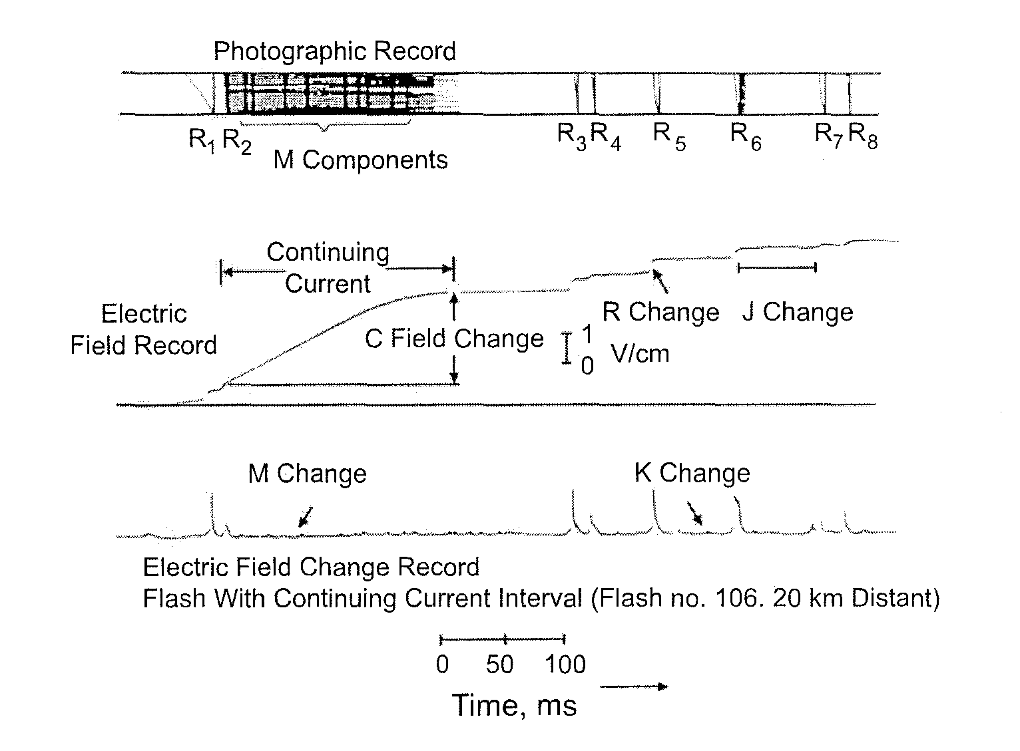
↓
τ = 4 s, low gain
↓
τ = 70 µs,
high gain

Slide 7
Thevenin equivalent circuit of electric field antenna shown along with the integrating capacitance and the input impedance of recorder (usually C>>C_{a} and C>>C_{in}).
V_{T} = I_{N} (1/jωC_{a}), where I_{N} = ε₀A jωE
For a unit-step-function E-field waveform,
V_{out} = (ε₀AE/C) exp(-t/(R_{in}C)),which becomes V_{out} = (ε₀AE/C) if
- in the time domain: t << τ or t << R_{in}C (practically impossible for quasi-static fields)
- in the frequency domain: 1/(ωC) << R_{in} => f >> 1/(2πR_{in}C) [lower frequency response]

Slide 8
Flat-plate antenna for measuring electric field (vertical cross-section and plan views) suitable for flush-mounting in the earth. Drawing by Potao Sun.

Slide 9
Flat-plate antenna

Slide 10
Elevated flat-plate antenna

Slide 11
(a) Flat-plate antenna flush with ground (no field enhancement), (b) elevated flat-plate antenna, and
(c) elevated flat-plate antenna on the top of building
V_{out} = (G_{electronics} Aε₀/C) E
E = K_{flush} V_{out}
For (a): V_{out} = (G_{electronics} 𝐴𝜀₀ /C ) E = E/K_{flush} and hence E = K_{flush} V_{out},
where K_{flush} is the calibration factor. For (b) and (c): E = K V_{out}
K_{flush} is found theoretically, G_{elevation} experimentally, and G_{building} numerically.

Slide 12
Course Sections | Number of Lectures | HW Due (Canvas) | Test (Honor-lock) | Section in Course Packet | Chapter/Sections in Text (FOL)
5. Calculation of lightning electromagnetic fields | 4 | HW6 04/14 | T6 04/16 | 5 | 5, App. 3
6. Modeling of lightning processes | 3 |  |  | 6 | 6
7. Measurements of lightning electric and magnetic fields | 2 |  |  | 7 | 7
8. Lightning locating systems and lightning protection | 2 | - | - | 8,9 | 8,9
Review | 1 |  |  | 1-9 | 1-9, App. 1-4
Final Exam (via Honorlock) | - | - | Apr. 28 (W) 12:30-2:30 p.m. | 1-9 | 1-9, App. 1-4

Slide 13
Signal to be
measured:
E = 1 kV/m
Δt = 0.5 ms
Recorder:
V_{out} = 2.5 V (±5 V)
R_{in} = 1 MΩ
C_{in} = 30 pF
Design
parameters:
C and A
C = (ε₀AE/V_{out})
Δt << R_{in}C

Slide 14
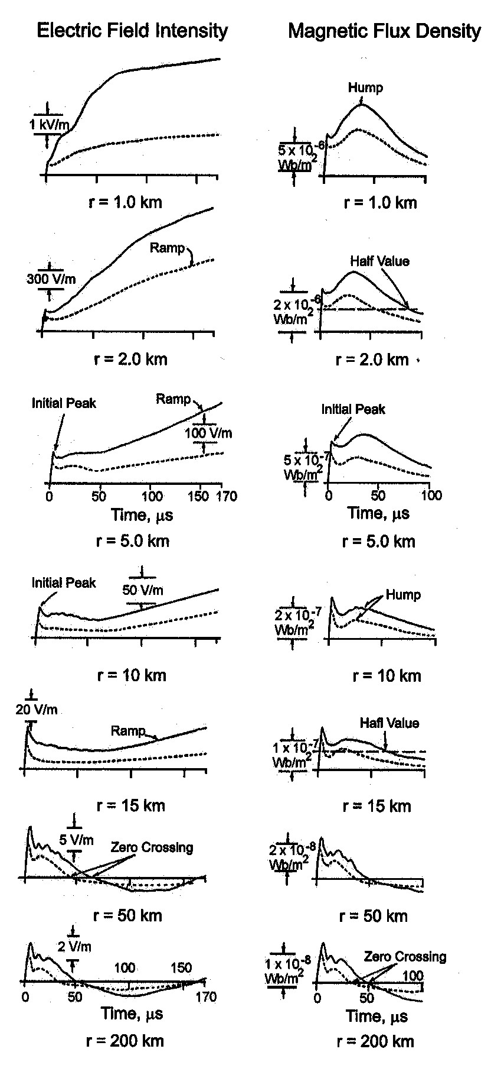
Typical measured vertical electric field intensity (left column) and azimuthal magnetic flux density (right column) waveforms for first (solid line) and subsequent (dashed line) return strokes at distances of 1, 2, 5, 10, 15, 50, and 200 km. Adapted from Lin et al. (1979).
14

Slide 15
(a) Illustration of the principle of operation of the electric field mill. Adapted from Bazelyan and Raizer (2000). (b) Electric field mill operating at Camp Blanding, Florida. Photograph by Joseph Howard.

Slide 16

Estimation of Input Energy in Rocket-Triggered Lightning Strokes
Vertical electric field, E(t), measurements inside or in the immediate vicinity of the lightning channel and current, I(t), measurements at the channel base can be used to estimate power per unit length, P(t) = E(t) I(t), as a function of time. Integrating this power over time, we can estimate lightning input energy per unit length, W(t).
Lightning channel
I(t)
E(t)
R(t) = E(t)/I(t)
r(t) = [σ π R(t)]^{-1/2}
r
Lightning input energy is needed in a number of areas including the estimation of NO_{x} produced by lightning, evaluation of lightning shock-wave effects, and testing of thunder generation theories.
Resistance per unit length, R(t), and channel radius, r(t) can be also estimated.
16

Slide 17
Illustration of Pockels effect. Adapted from Miki et al. (2002).

Slide 18
Schematic representation of experimental setup used to measure two components of electric field 01-1.6 m from the lightning channel with Pockels sensors. Adapted from Miki et al. (2002).

Slide 19
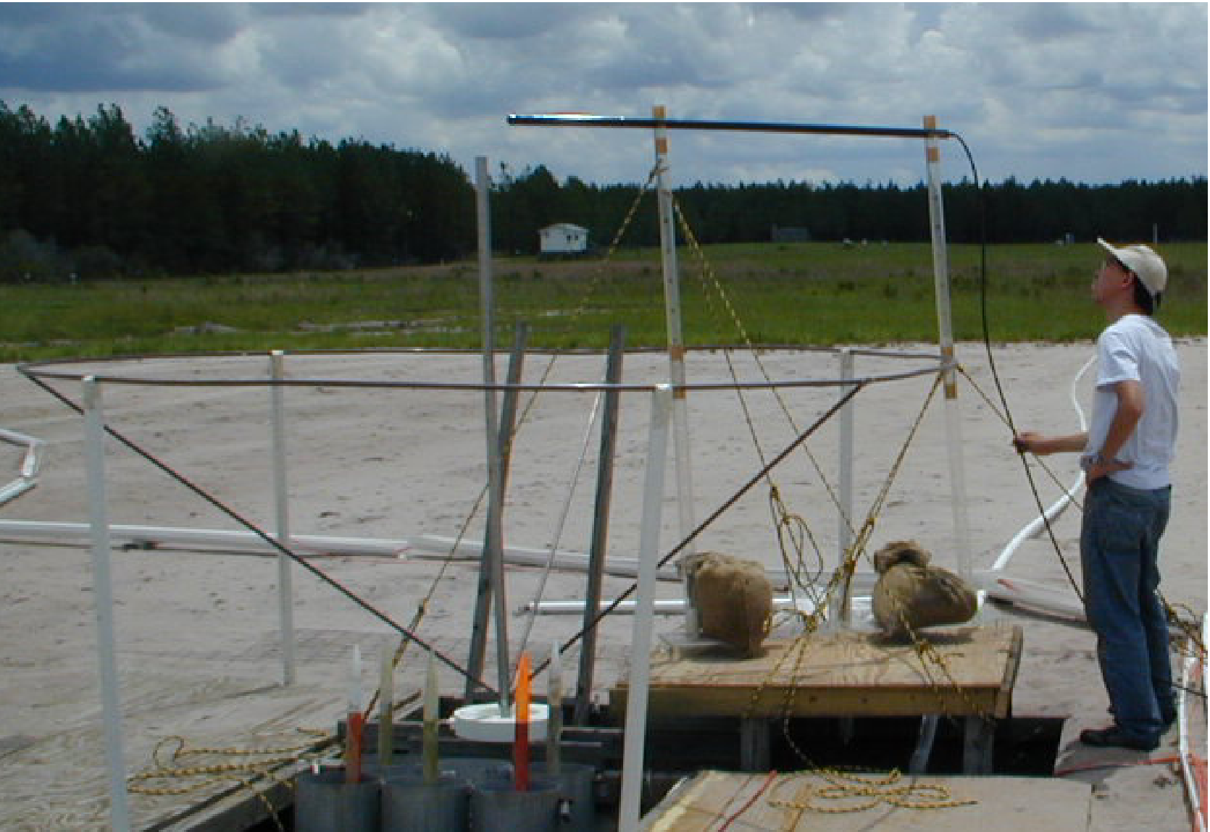
Electric Fields in the Immediate Vicinity of the Lightning Channel
Vertical and horizontal (radial) components of electric field in the immediate vicinity (within 0.1 to 1.6 m) of the triggered-lightning channel were measured with Pockels sensors at Camp Blanding, Florida, in 2000 (Miki et al., 2002)
2-meter strike rod
Pockels sensor:
KDP (KH₂PO₄) crystal 20 kV/m – 5 MV/m
50 Hz – 1 MHz
Rocket launcher
19

Slide 20
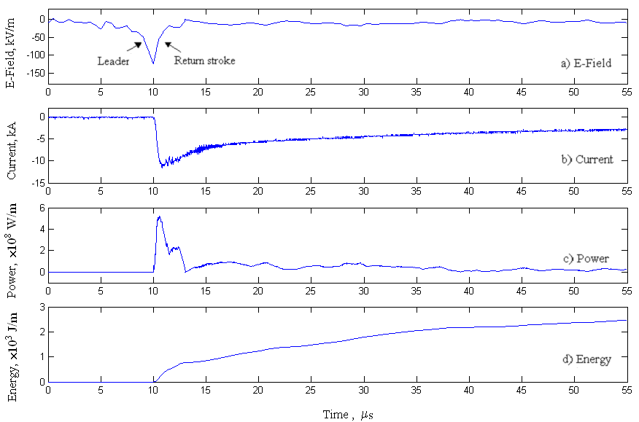
Estimation of Input Energy in Rocket-Triggered Lightning Strokes
a) E-Field
b) Current
R(t) = 5 Ω/m, r(t) = 3 mm at power peak (σ = 10⁴ S/m)
0.5 GW/m
(peak)
c) Power
3 kJ/m
(at 46 μs)
d) Energy
Flash 0013, stroke 1. a) Vertical electric field 10 cm from the lightning channel attachment point, b) current at the channel base, c) power per unit channel length, d) energy per unit channel length. Adapted from Jayakumar et al. (2006).
20

Slide 21
Norton equivalent circuit of electric field antenna shown along with the integrating capacitance and the input impedance of recorder (usually C>>C_{a} and C>>C_{in}). Drawing by Potao Sun.
V_{out} = (ε₀AE/C) if R_{in} >> 1/(ωC

Slide 22
Illustration of the principle of operation of the loop antenna. Drawing by Potao Sun.

Slide 23
(B = B_{n})
Thevenin equivalent circuit of magnetic field antenna shown along with the integrating circuit and the input impedance of recorder (C>>C_{in}).
V_{out} = AB_{n}/(RC), if the following 3 conditions are met:
R >> ωL (ω << R/L, upper frequency response),
R_{in} >> R (C discharges through R, not R_{in}), and
3) R >> 1/(ωC) (ω >> 1/(RC), lower frequency response).

Slide 24
Norton equivalent circuit of magnetic field antenna shown along with the integrating circuit and the input impedance of recorder. Drawing by Potao Sun.

Slide 25
Loop antenna with single-ended output developed by George Schnetzer. (a) Schematic diagram; (b) Thevenin equivalent circuit. Drawing by Potao Sun.

